Slide 1
Frustratingly Simple Pretraining Alternatives
to Masked Language Modeling（EMNLP2021）
2021.09.28
Reported by Xiaoke Li

Slide 2
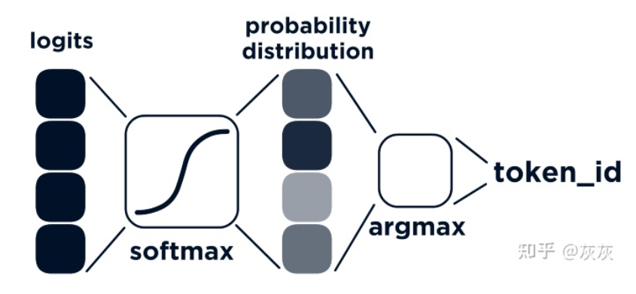
Mask language model

Slide 3
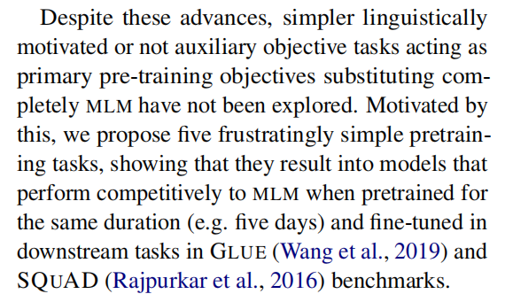
Introduction

Slide 4
Contribution
(1) To the best of our knowledge,this study is the first to investigate whether linguistically and non-linguistically intuitive tasks can effectively be used for pretraining.
(2) We empirically demonstrate that our proposed objectives are often computationally cheaper and result in better or comparable performance to MLM across different sized models.

Slide 5
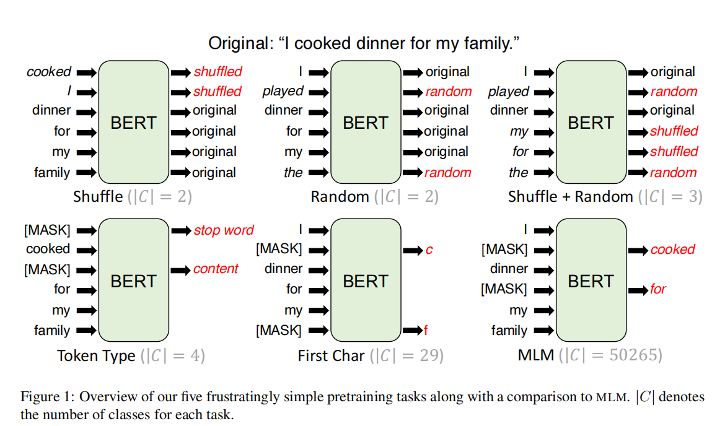
Method

Slide 6
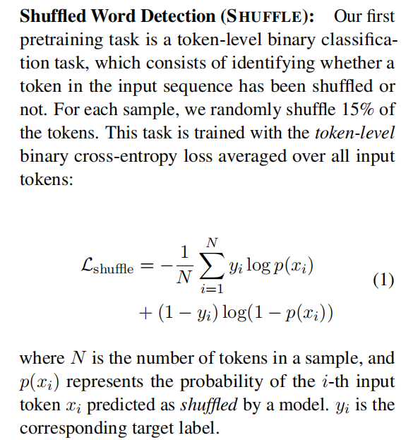
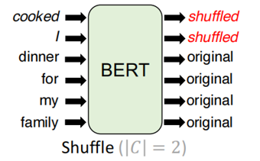
Method

Slide 7
Method

Slide 8
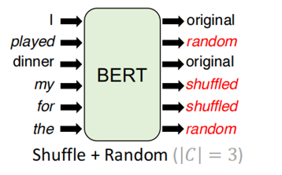
Method

Slide 9
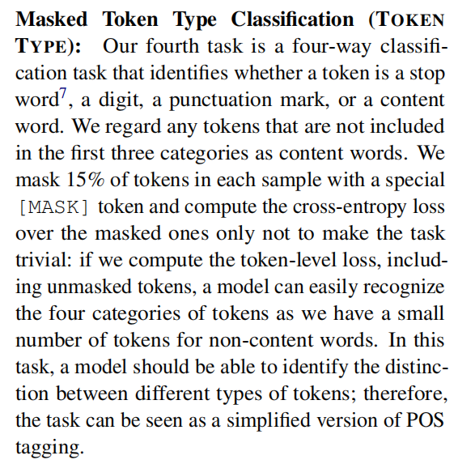
Method

Slide 10
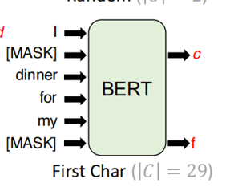
Method

Slide 11
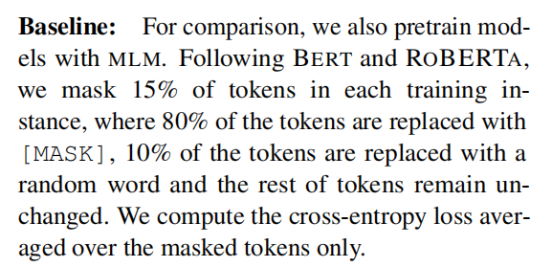
Method

Slide 12
Experiments

Slide 13
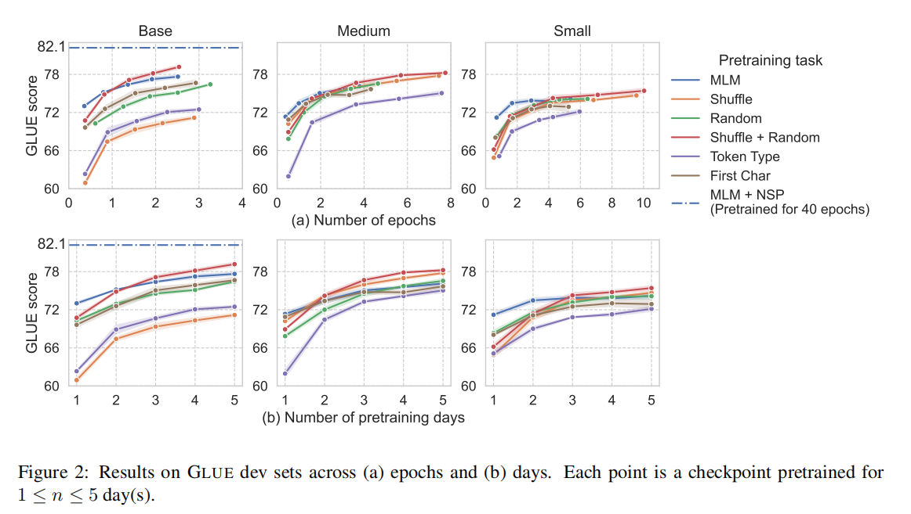
Experiments

Slide 14
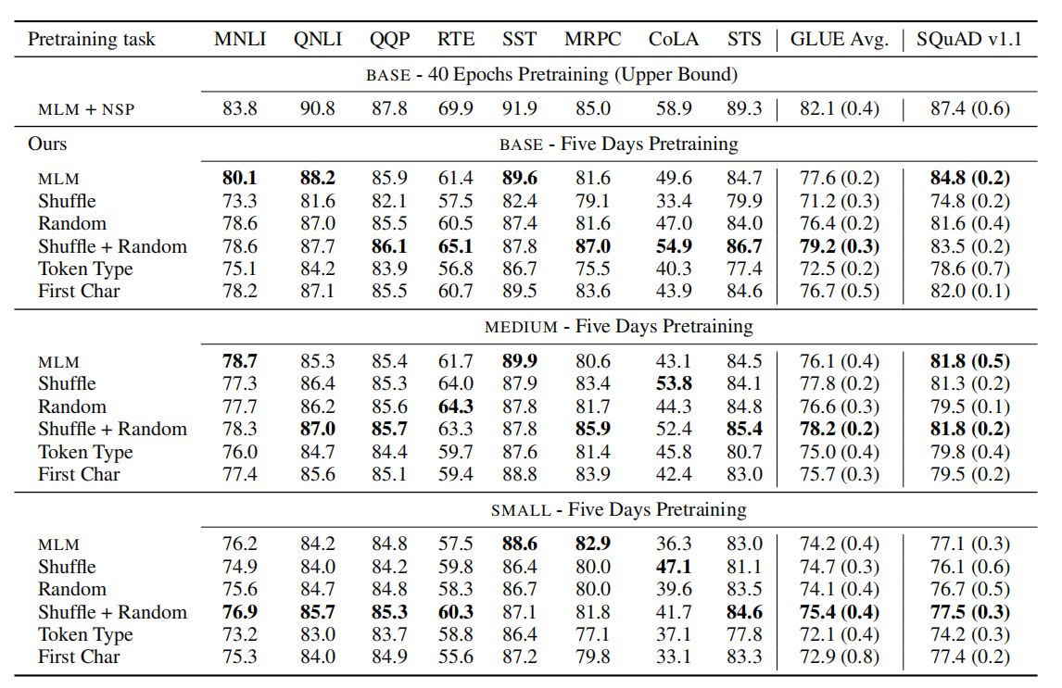
Experiment

Slide 15
Thanks

